Slide 1
Bradley Schoeneweis

Slide 2



Slide 3
NoSQL Databases
4 basic types:
Key-Value Store: Big hash table
DynamoDB, Voldemort, Redis
Wide-Column Stores: Column based instead of row based
Cassandra, HBase
Document Databases: Complex documents (JSON, BSON)
MongoDB, CouchDB
Graph Databases: Edges and nodes to store data
Neo4J, HyperGraphDB

Slide 4
Advantages over Relational
Schema-less
No joins necessary, no complex transactions
Horizontally scalable
New data models
Fast data access
Cisco migrated from a relational database to MongoDB, and it reduced “latency 8x and eliminated downtime during system upgrades”
Easy to scale
Auto-Sharding
Very difficult with relational, no need to rely on one server

Slide 5
Use Cases?
Single View Applications
Aggregation of data from multiple sources into a central repository
IoT
Mobile
Real-Time Analytics
Personalization Applications
Catalogs

Slide 6
MongoDB Definitions
Database – Holds the collections, each MongoDB server instance usually has multiple databases
Collection – Group of documents that exist within Databases. Has no schema, so can have different field with different data types (usually similar/related)
Document – Set of key value pairs (in BSON: Binary JSON)

Slide 7
Terminology Overlap
SQL
MongoDB
Database
Table
Row
Column
Relationships / JOINs
Group By
Primary Key: Assigned to a
particular value, can use *_id
Database
Collection
Document
Field
Embedding Documents
Aggregation Pipeline
Primary Key: ‘_id’, automatically
generated

Slide 8
Document Format
Field is the key
Value can be any BSON data type
E.G. Timestamps, Strings, Arrays, ObjectID’s, Embedded Documents
Data types can vary for every document in a collection
{
field1: value1,
field2: value2,
field3: value3,
...
fieldN: valueN
}

Slide 9
Example Document
{
_id: ObjectId("5099803df3f4948bd2f98391"),
name: { first: "Alan", last: "Turing" },
birth: new Date('Jun 23, 1912’),
death: new Date('Jun 07, 1954’),
contribs: [ "Turing machine", "Turing test", "Turingery" ],
views : NumberLong(1250000)
}

Slide 10
Interaction with MongoDB
Shell (like MySQL)
Scripting (using JavaScript)
Driver Languages
Python, Java, Rust, C++, etc.

Slide 11
Basic Shell ‘Read’ Operations
db – Shows current database
show dbs – Shows all databases
use db – Selects a database
show collections – Shows all collections in a db
db.collection.find() – Shows all documents in a collection
db.collection.find().pretty() – Much more readable

Slide 12
CRUD Operations: Create
Can also do db.users.insertMany() with each document separated by a comma.

Slide 13
CRUD Operations: Read
$ = operator
The query criteria, projection, and cursor modifier are all optional, and have many different options/methods that can be referenced in the docs

Slide 14
CRUD Operations: Update
Other common operations include:
updateOne()
updateMany()

Slide 15
CRUD Operations: Delete
Other common operations include:
deleteOne()

Slide 16
Other Common Operations
Sorting
db.collection.find().sort({name: 1})
1 is ascending order, use -1 for descending order
Limit/Skip
db.collection.find().limit(5)
Limits the return value to 5 documents
db.collection.find().skip(2)
Skips the first 2 stored documents
Projection
db.find({}, {name: 1, _id: 0}
Only shows the name field, suppresses _id
Can’t overlap 1’s and 0’s unless it’s _id

Slide 17
Operators
Comparison
$eq, $gte, $gt, $lte, $lt, $ne, etc.
db.inventory.find({qty: {$gte: 20}})
Logical
$and, $or, $not, $nor
db.inventory.find({$or: [{qty: {$lte: 50}, {price: 15}]})

Slide 18
Update Operator
$set
Updates a field or adds a new field if it doesn’t exist.
Db.products.update({_id: 4}, {$set: {qty: 50, price: 10}})
$rename
$unset

Slide 19
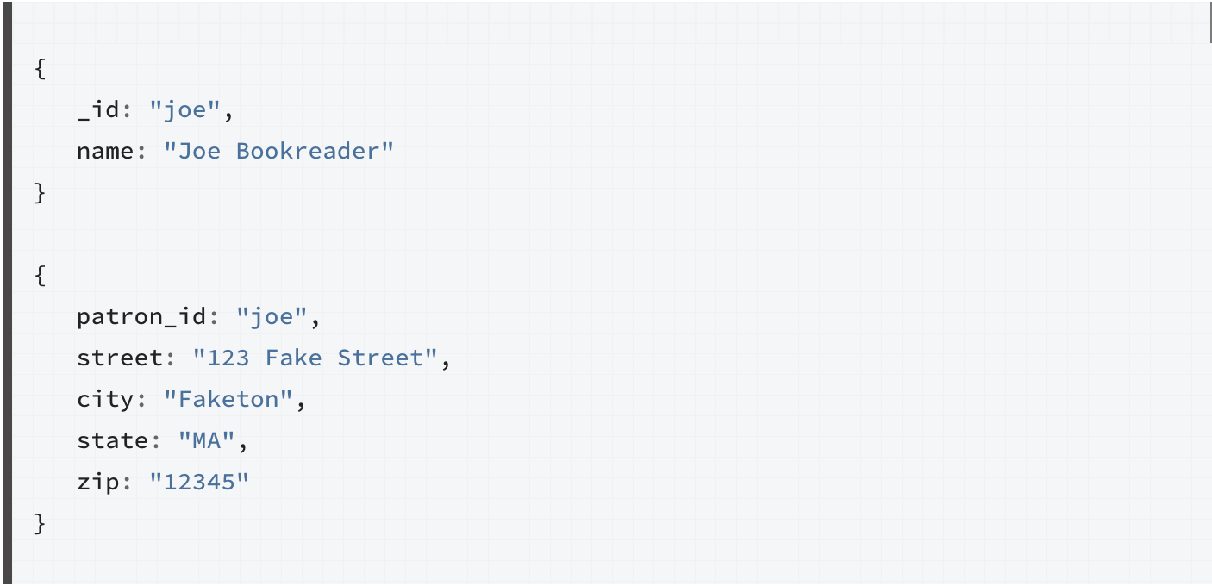
One-to-One: Normalized

Slide 20
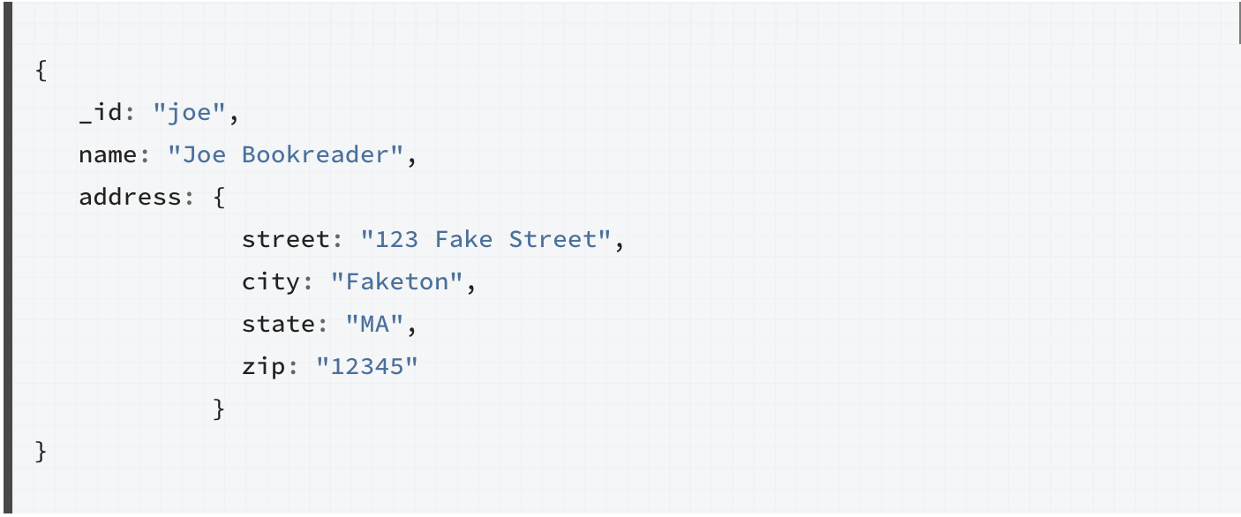
One-to-One: Embedded

Slide 21
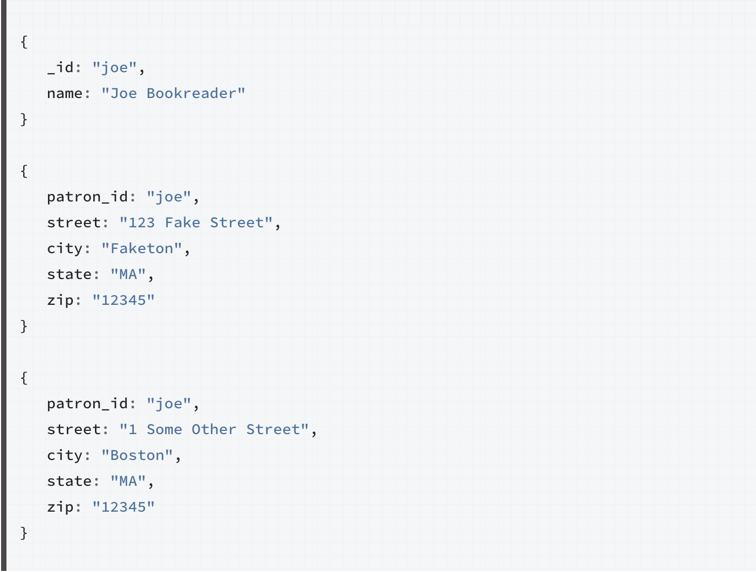
One-to-Many: Normalized

Slide 22
One-to-Many: Normalized

Slide 23
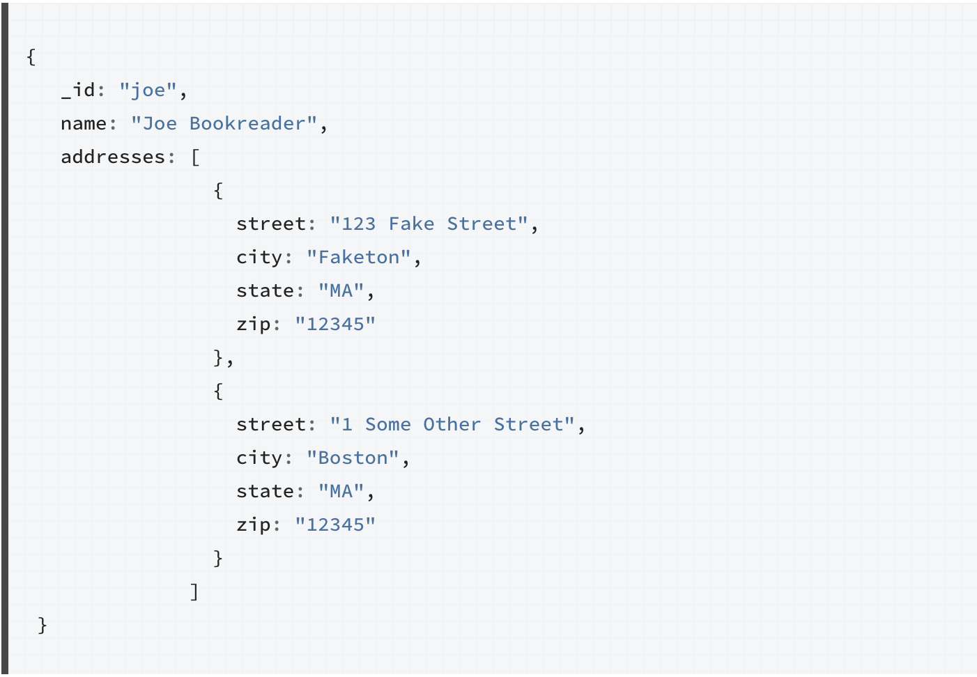
One-to-Many: Embedded

Slide 24
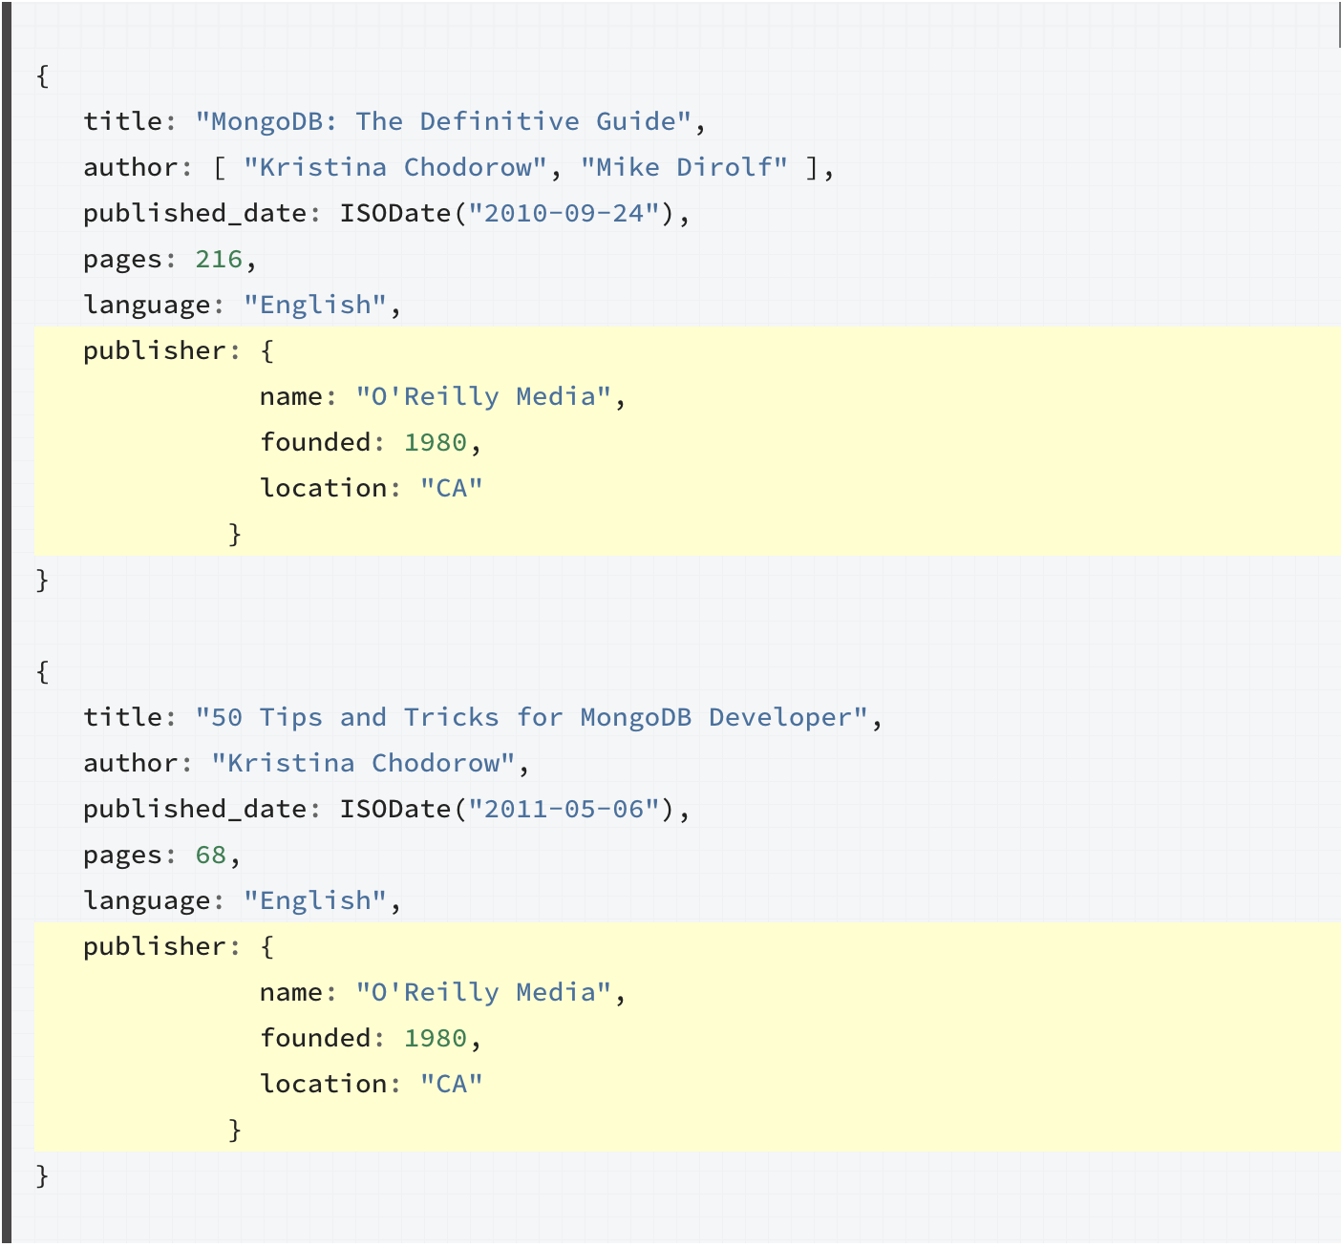

Slide 25
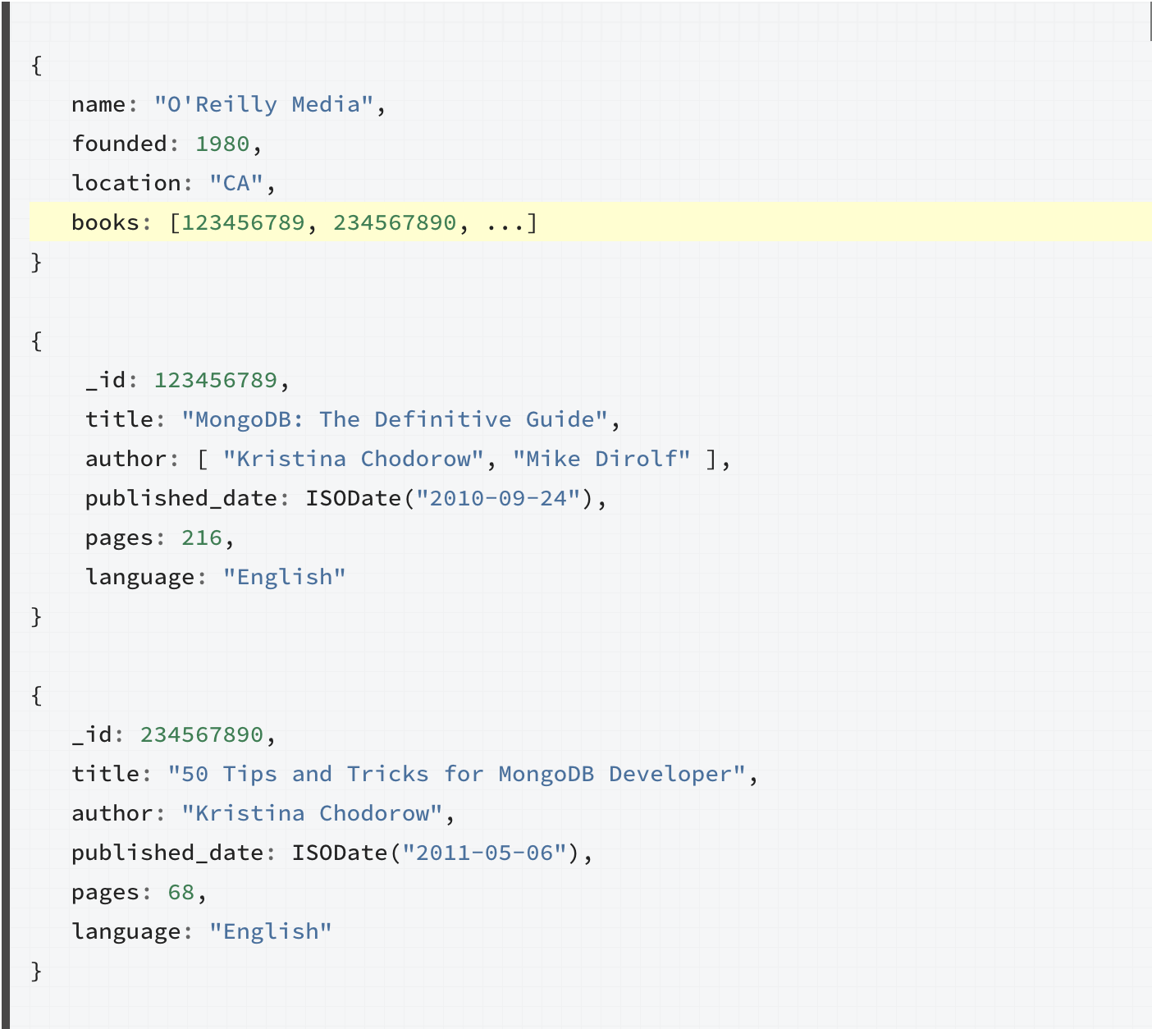

Slide 26
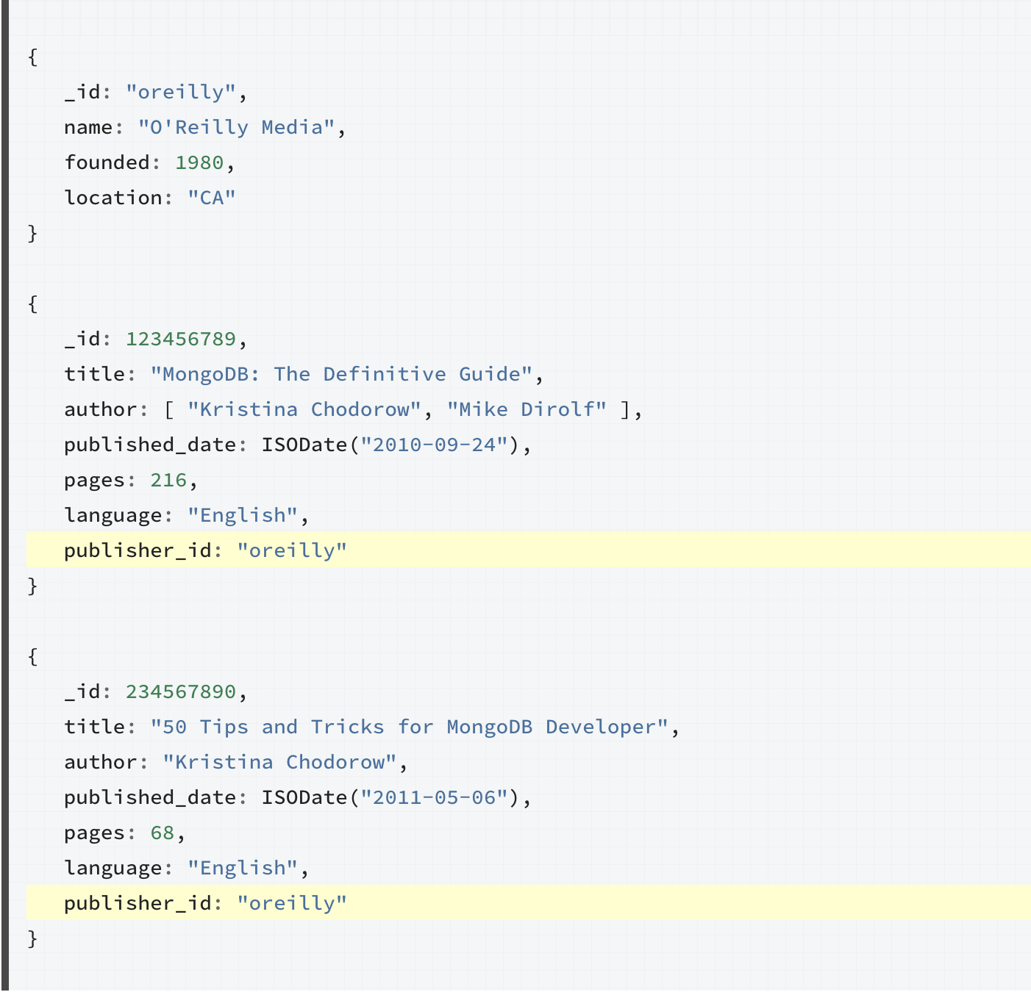

Slide 27
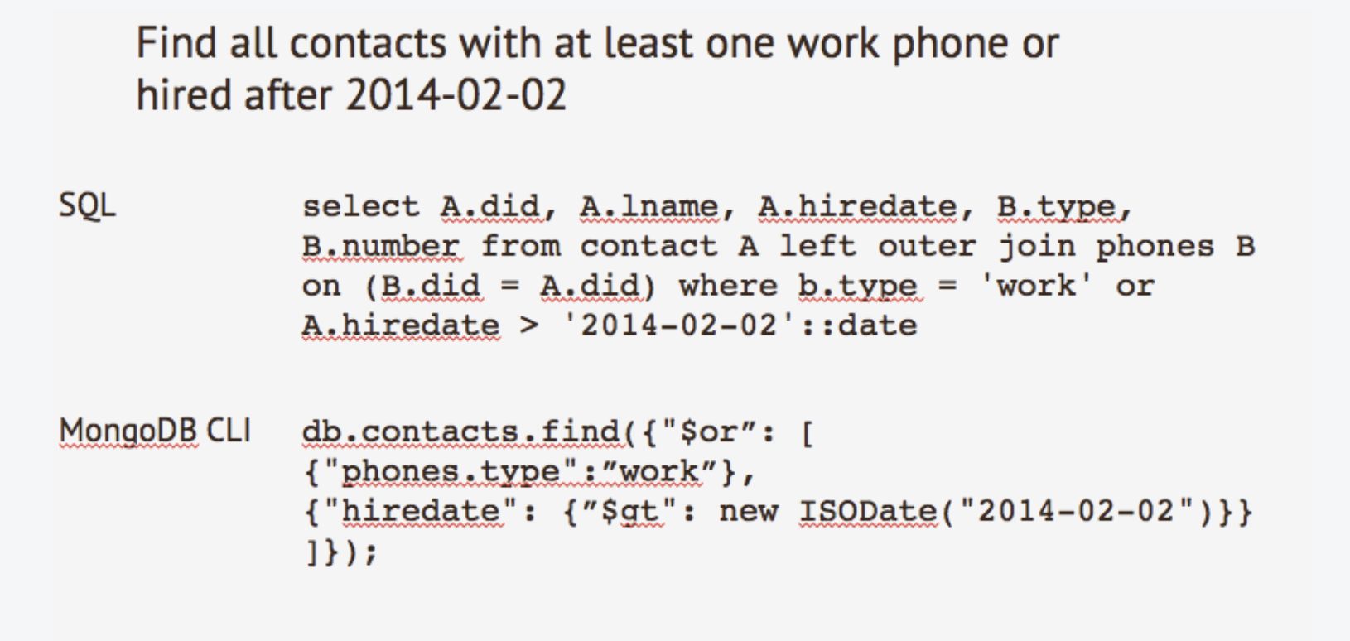
More Complex Query

Slide 28
Script Usage

Slide 29
Shell Usage

Slide 30
Sources
https://docs.mongodb.com/

